Slide 1







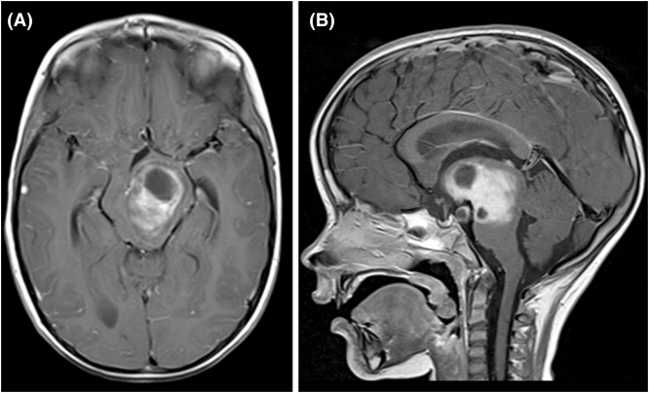
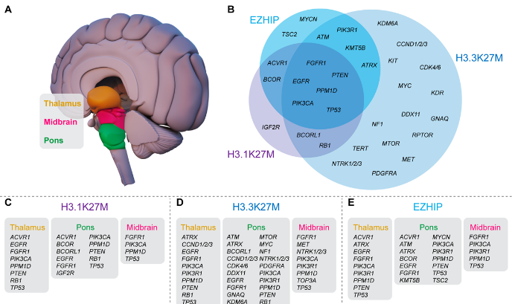
A multi-omically guided approach to the treatment of diffuse midline gliomas
Izac J. Findlay ^{1,2}, Dilana Staudt ^{1,2}, Padraic Kearney ^{1,2}, Mika L. Persson ^{1,2}, Holly McEwen ^{1,2}, Ryan J. Duchatel ^{1,2}, Evangeline R. Jackson ^{1,2}, Nathan D. Smith ³, Nicholas A. Vitanza ^{4,5}, Jason E. Cain ^{6,7}, Sebastian M. Waszak ^{8,9}, Mitchell Hansen ¹⁰, Frank Alvaro ^{1,2,11}, Matthew D. Dun ^{1,2}
Cancer Signalling Research Group, School of Biomedical Sciences and Pharmacy, College of Health, Medicine & Wellbeing, University of Newcastle, Callaghan, NSW, Australia
Precision Medicine Research Program, Hunter Medical Research Institute, New Lambton Heights, NSW, Australia
Analytical and Biomolecular Research Facility, University of Newcastle, Newcastle, NSW, Australia
Ben Towne Center for Childhood Cancer Research, Seattle Children's Research Institute, Seattle, WA, USA
Division of Pediatric Hematology/Oncology, Department of Pediatrics, Seattle Children's Hospital, Seattle, WA, USA
Hudson Institute of Medical Research, Melbourne, VIC, Australia
Department of Paediatrics, Monash University, Melbourne, VIC, Australia
Centre for Molecular Medicine Norway (NCMM), Nordic EMBL Partnership, University of Oslo and Oslo University Hospital, Oslo, Norway
Department of Neurology, University of California, San Francisco, CA, USA
Surgical Department, John Hunter Hospital, Newcastle, NSW, Australia
John Hunter Children's Hospital, Newcastle, NSW, Australia
1. Diffuse Midline Glioma (DMG)
2. Precision Therapies for DMGs
Diffuse midline gliomas (DMG) are tumours of the glial cells in the midline regions of the brain (Figure 1).
Median overall survival for DMGs is 9-15 months.
Localisation precludes surgical resection, leaving palliative radiotherapy as standard treatment.
Desperate need for effective precision therapies
Patients can be given targeted therapies based on tumour genome analysis.
Genomic sequencing has provided a greater understanding of DMGs (Figure 2), however, has failed to improve patient outcomes.
Genomic analysis alone, is unable to explain how mutations influence tumour growth.
Analysis of the proteins/phosphoproteins within tumours can explain their rapid development and proliferation.
Coupling proteins and signalling pathways with genetic mutations, provides a systems-wide understanding of a tumour.
Figure 1: Radiographic findings of a midline high-grade glioma. (a) axial and sagittal (b) post-gadolinium MR images of a 6-year-old boy (Juratli et al, 2018).
Figure 2: Molecular subtypes of diffuse midline glioma including recurrent somatic alterations (Findlay et al., 2021).
HYPOTHESIS: The characterisation of the genome, proteome and phosphoproteome will allow for the development of effective treatment strategies for diffuse midline gliomas.
3. SU-DIPG-XIII Multi-omics
4. UON-VIBE5 Multi-omics
Gene | Impact | HGVS.p
H3F3A | missense_variant | NP_002098.1:p.Lys28Met
TP53 | missense_variant | NP_000537.3:p.Lys132Arg
RNF43 | missense_variant | NP_060233.3:p.Val627Ala
PRDM1 | missense_variant | NP_001189.2:p.Pro492Ser
MSH3 | missense_variant | NP_002430.3:p.Gly896Arg
MTOR | missense_variant | NP_004949.1:p.Ser932Asn
BCORL1 | missense_variant | NP_068765.3:p.Pro262Ala
RECQL4 | missense_variant | NP_004251.3:p.Ile716Met
PTCH1 | missense_variant | NP_000255.2:p.Arg1338Cys
BCORL1 | inframe_deletion | NP_068765.3:p.Glu1324del
PIK3C2B | frameshift_variant | NP_002637.3:p.Glu1463Ter
Genomic sequencing of SU-DIPG-XIII identified 11 predicted somatic alterations (Table 1).
The majority of these mutations are of currently unknown clinical significance.
Mutations whose effect is known, such as the TP53 mutations, are currently untargetable.
Gene | Impact | HGVS.p
PDGFRA | missense_variant | NP_006197.1:p.Asp842Val
H3F3A | missense_variant | NP_002098.1:p.Lys28Met
PPM1D | frameshift_variant | NP_003611.1:p.Asn512LysfsTer16
PPM1D | missense_variant | NP_003611.1:p.Asn512Lys
ZFHX3 | missense_variant | NP_008816.3:p.His620Gln
PTPRS | missense_variant & splice_region_variant | NP_002841.3:p.Asn1539His
Genomic sequencing of UON-VIBE5 identified 6 predicted somatic alterations (Table 2).
The PDGFRA mutation (D842V), has been reported in gastrointestinal stromal tumours ]targeted with Avapritinib, a PDGFR inhibitor.
Avapritinib is currently in clinical trials testing on PDGFRA/KIT mutant solid tumours.
Table 1: SU-DIPG-XIII Somatic Alterations.
Table 2: UON-VIBE5 Somatic Alterations.
Pathway analysis revealed enrichment of pathways responsible for HDAC deacetylation of histones and cell cycle checkpoint transition in SU-DIPG-XIII relative to HMC3 (Figure 3).
Findings suggest the use of HDAC, BRD/BET and CDK protein inhibitors on SU-DIPG-XIII.
Pathway analysis revealed enrichment of ATM-centric pathways responsible for DNA damage response and mismatch repair (Figure 4).
Findings suggest the use of the novel ATM inhibitor, WSD-0628.
Figure 3: Pathway enrichment analysis of SU-DIPG-XIII.
Figure 4: Pathway enrichment analysis of UON-VIBE5.
SU-DIPG-XIII
Fimepinostat (HDAC/PI3Ki) in combination with iBET858 (BETi) and Ribociclib, (CDKi) was tested on SU-DIPG-XIII tumour cells and HMC3 normal cells (Figure 5).
All combinations synergistically inhibited tumour cell proliferation at lower doses.
Avapritinib (PDGFRAi) and WSD-0628 (ATMi) were tested on UON-VIBE5 and HMC3 normal cells (Figure 6).
Avapritinib from 5uM failed to elicit a response in UON-VIBE5.
WSD-0628 from 0.5uM showed efficacy at inhibiting VIBE5 growth.
HMC3
Figure 5: In vitro cytotoxicity assays of SU-DIPG-XIII.
Figure 6: In vitro cytotoxicity assays of UON-VIBE5.
6. Conclusions
5. Further In Vitro Validation
To further validate these treatment predictions, we tested Avapritinib and WSD-0628 on the RA055 DMG cell line (Figure 7).
RA055 harbours a PDGFRA amplification and H3.3K27M and TP53 mutations, akin to the UON-VIBE5 model.
Similar to UON-VIBE5, Avapritinib failed to elicit a response in tumour cells while WSD-0628 was effective at reducing cell proliferation.
A systems-wide approach in pHGGs to uncover the protein-controlled functional outcomes of somatic genetic alterations.
In vitro testing of proteomics proteomics-based targets for SU-DIPG-XIII and UON-VIBE5 proved effective in inhibiting cell proliferation while UON-VIBE5’s genomically predicted therapy was unsuccessful.
The combination of genomics and proteomics predicted targets acted synergistically in reducing RA055 cell proliferation.
Future work will be testing more multi-omically predicted therapies and performing a similar analysis on a wider range of samples to gain a better understanding of the biology of pHGGs.
Figure 7: In vitro cytotoxicity assays of RA055.
Interestingly, Avapritinib and WSD-0628 combination acted synergistically to reduce RA055 cell proliferation at lower doses.
These results thus highlight the need to take a multi-omic approach when treating these heterogeneous tumours.
References
Juratli, T. A., Qin, N., Cahill, D. P. & Filbin, M. G. Molecular pathogenesis and therapeutic implications in pediatric high-grade gliomas. Pharmacology & Therapeutics 182, 70-79, doi:https://doi.org/10.1016/j.pharmthera.2017.08.006 (2018).
Findlay, I. J. et al. Pharmaco-proteogenomic profiling of pediatric diffuse midline glioma to inform future treatment strategies. Oncogene 41, 461-475, doi:10.1038/s41388-021-02102-y (2022)., doi:10.1038/s41388-021-02102-y (2021).

